Slide 1
MAR 580: Models for Marine Ecosystem Based Management
Lecture 6
Models for Marine Spatial Planning Reserve design using Marxan
Acknowledgements: Marxan training team, Matthew Watts, Megan Evans
www.uq.edu.au/spatialecology
11 March 2016

Slide 2
Simplified Schedule
Week | Topic | Assignments
1/29 | Intro to EBM, review of fisheries assessment models
2/5 | No Class - weather
2/12 | Stock assessment models with ecosystem processes
2/19 | Guest lecture: Food web models I (Ecopath) | HWK 1 due
2/26 | Guest lecture: Food web models II (Ecosim) | Project outlines
3/ 4 | Multispecies models, estimating species interactions
3/11 | Marine spatial planning models, marine reserve design | HWK 2 due
3/18 | SPRING BREAK
3/25 | No Class - IMS Research Symposium (several mini-lectures) | HWK 3 due
4/1 | Valuation of ecosystem services
4/8 | No Class – Stock Synthesis training course | HWK 4 due
4/15 | Whole of system models, MSE for ecosystems
4/22 | Qualitative modeling, model structure uncertainty | HWK 5 due
4/29 | Participatory modeling, multicriteria decision analysis
5/6 | Final exam: Project Presentations | Final papers

Slide 3
Today’s Outline
Review EM algorithm
Models for spatial planning, reserve design
Marxan
LAB / ASSIGNMENT
Marxan tutorial
Marine reserve selection around Rottnest Island to protect seagrass habitat

Slide 4
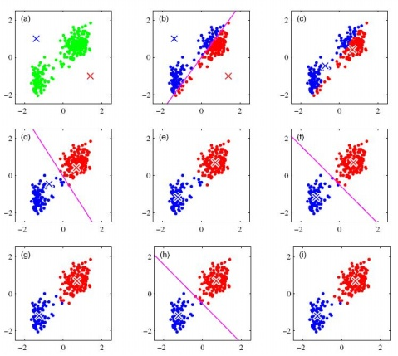
k-means as special case of Expectation-Maximization algorithm
Expectation: what are the clusters given the current cluster means?
Initialize with random locations for cluster means (k=2)
Maximization: what are the values for the means that maximize the objective function?
(minimize within group SS)
Next iteration Expectation.
MARSS: Expectation: predict latent states, Maximization: find parameters that maximize likelihood given those states.

Slide 5
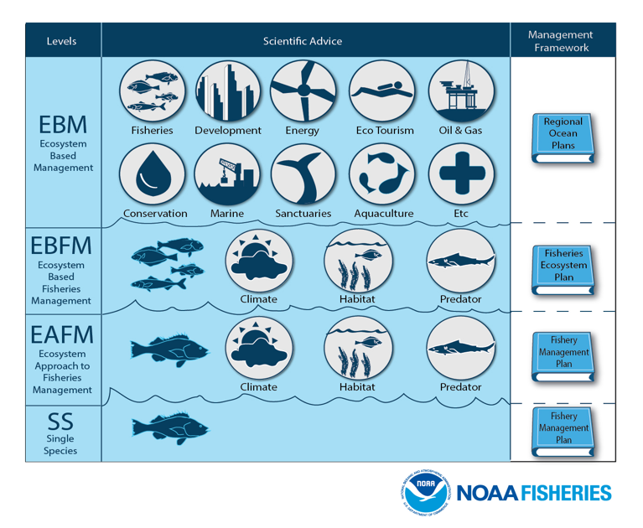

Slide 6
EBM Definitions
“U.S. ocean and coastal resources should be managed to reflect the relationships among all ecosystem components, including human and nonhuman species and the environments in which they live. Applying this principle will require defining relevant geographic management areas based on ecosystem, rather than political, boundaries.”
U.S. Commission on Ocean Policy

Slide 7
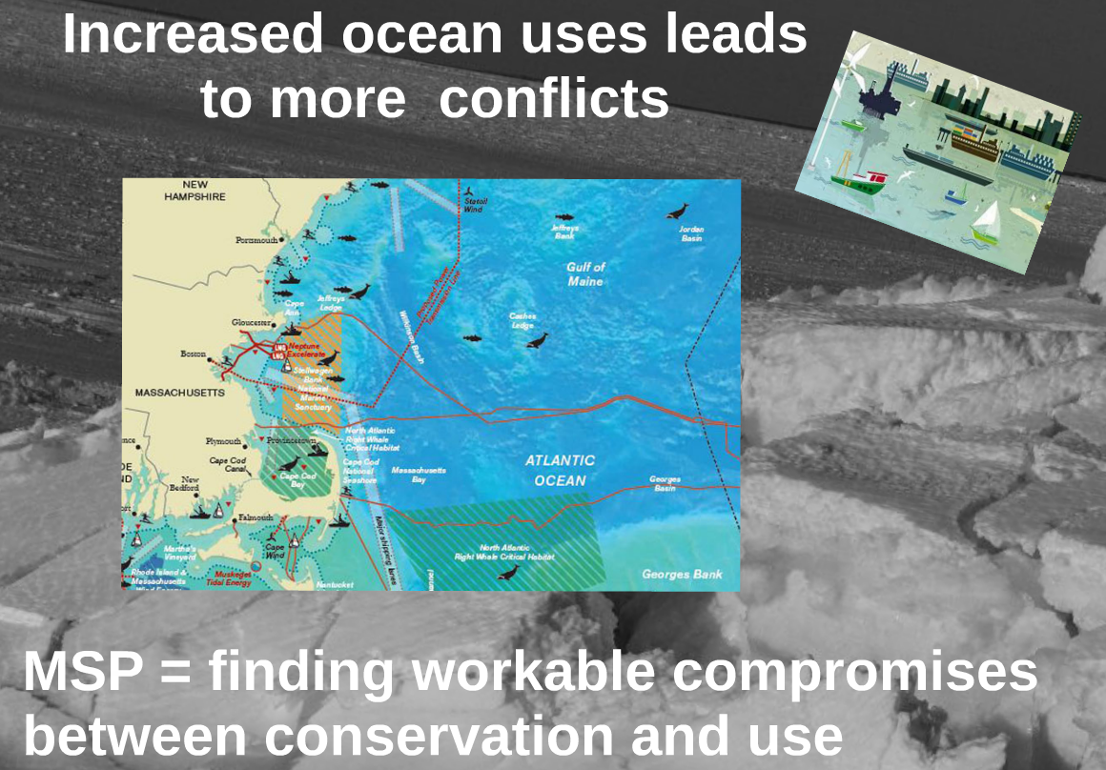
n
Slide courtesy of Erik Olsen, IMR Norway

Slide 8
Spatial planning
Much of the work on marine EBM has taken the form of regional spatial planning.
“EBM is abstract and impractical”
“MSP is intuitive and well-known.” [Olsen 2016]
Marine Spatial Planning exercises typically involve:
Evaluating tradeoffs among and cumulative impacts of multiple human activities.
Developing spatial solutions that balance these uses given some cost function.
Extensive stakeholder engagement and participation to evaluate options.

Slide 9
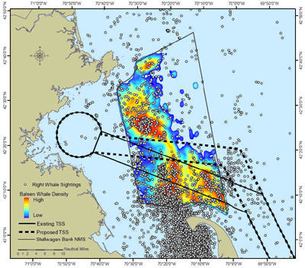
Right whales in Massachusetts, shipping lanes
Risk analysis of ship-strike to whales using maps of whale sightings, habitats, human uses and information on whale feeding ecology.
Is it possible to alter shipping lanes (with minimal cost) such that ship-strikes are reduced?
(NOAA Office of Protected Resources)

Slide 10
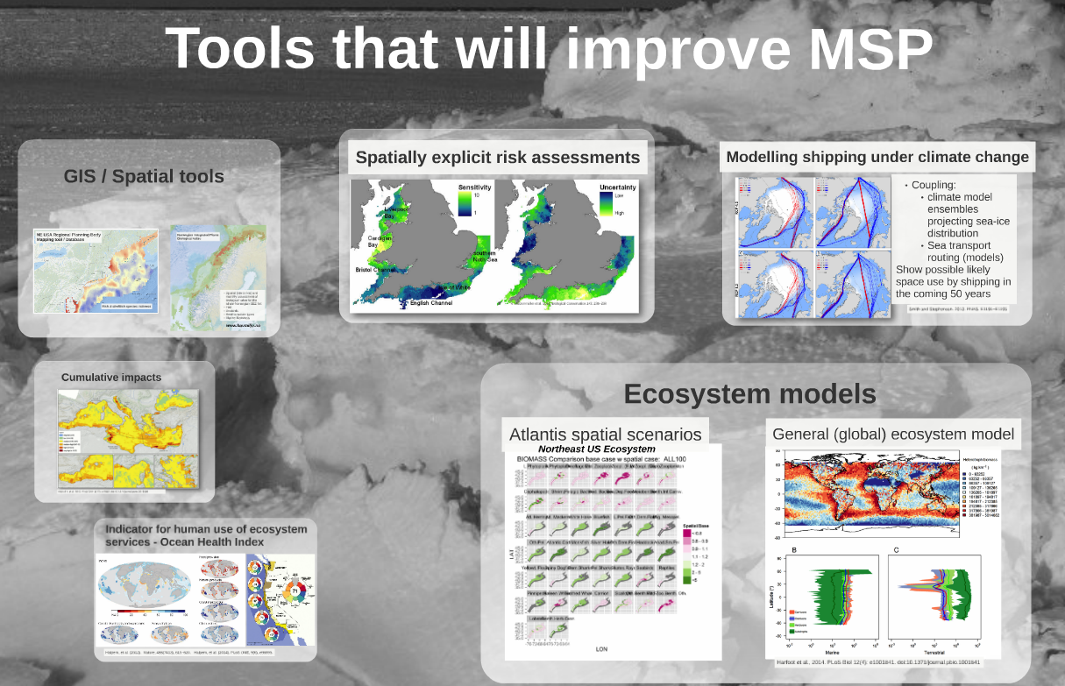
Tools for Marine Spatial Planning include static and dynamic models of ecosystem status and use.
hr
Image courtesy of Erik Olsen, IMR Norway

Slide 11
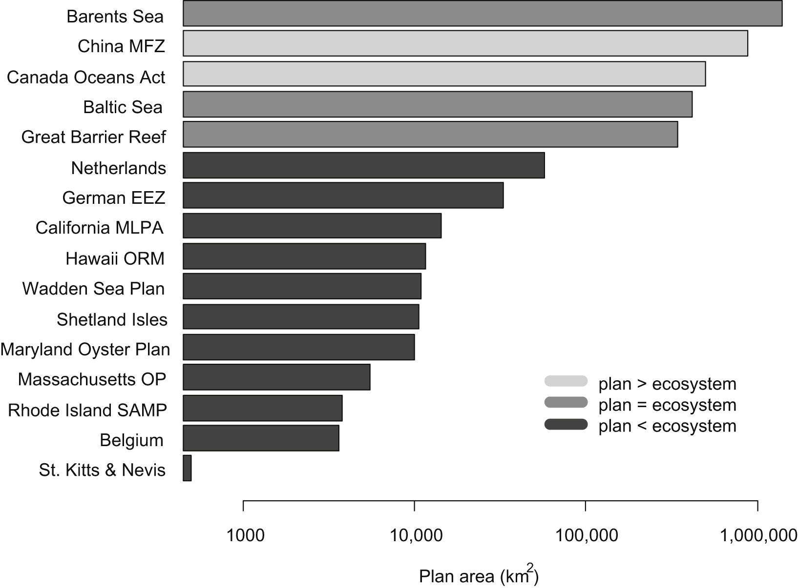
Marine spatial plans span multiple scales
Spatial scale of marine spatial plans. Shading indicates the area of the plan relative to the marine ecosystem: Light gray >, medium gray = , dark gray <.
(Collie et al. 2013)

Slide 12
Systematic spatial planning
Guide decisions about the location, configuration, and management of areas.
Efficient, repeatable, transparent and equitable processes for making decisions.
Areas managed for the persistence of biodiversity and other societal and ecological values (NOT just about reserves).
In a conservation planning context we may focus on identifying areas that provide the greatest benefit while minimizing costs.

Slide 13
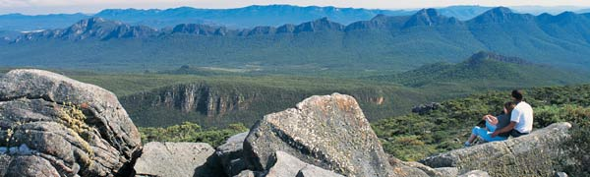

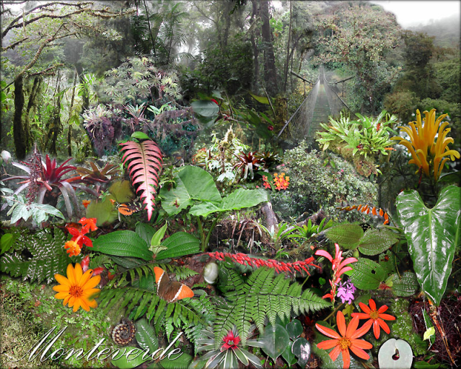

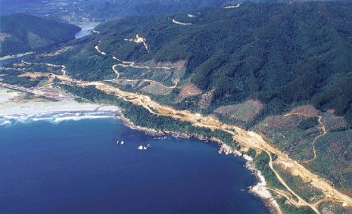
Reserve Design Problem What determines conservation priority?
Suitability for other uses,
scenic beauty, recreational value Charismatic animals
vs
All levels of biodiversity, ecosystem processes, cost-effectiveness, threats, condition …

Slide 14
Effective conservation plans are:
Comprehensive
Adequate
Representative
Efficient
Reserve site selection: need to first establish this question as a formal problem.
Two typical conservation area selection problems:
The minimum set problem; capture a set amount of biodiversity for the least cost.
The maximum coverage problem; capture as much biodiversity as possible given a fixed budget.

Slide 15
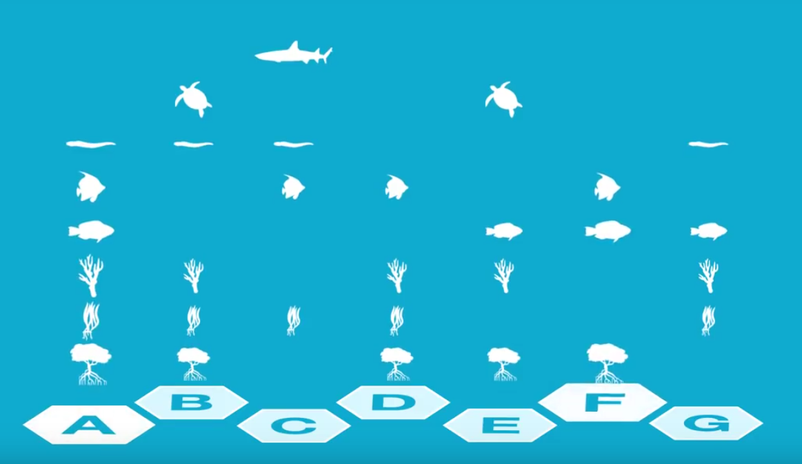
Reserve design problem
Site A has the most species, but need an additional 2 sites to include all species
Choosing sites C & E includes all species in fewer sites.

Slide 16
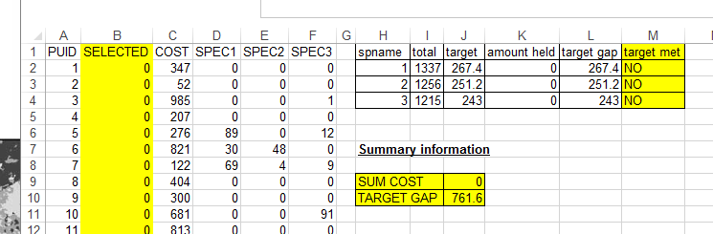
Reserve site selection hands-on exercise 1
“exercise_spreadsheet_ver2.xls”, worksheet “3 features”
We are interested in conserving at least 20% of the abundance of each of 3 species by siting some reserves.
We have 100 planning units as possible locations for reserves, each with different costs.
Goal – select a set of planning units that meets the target objectives while minimizing costs.
You have 5 minutes!

Slide 17
Reserve site selection
Identifying solutions that meet our targets is possible this way.
Can get difficult when needing to consider
many ecosystem features
lots of possible planning units
Additional factors or activities influencing cost of selecting certain sites.
Marxan is a decision support tool that addresses the minimum set problem systematically.

Slide 18
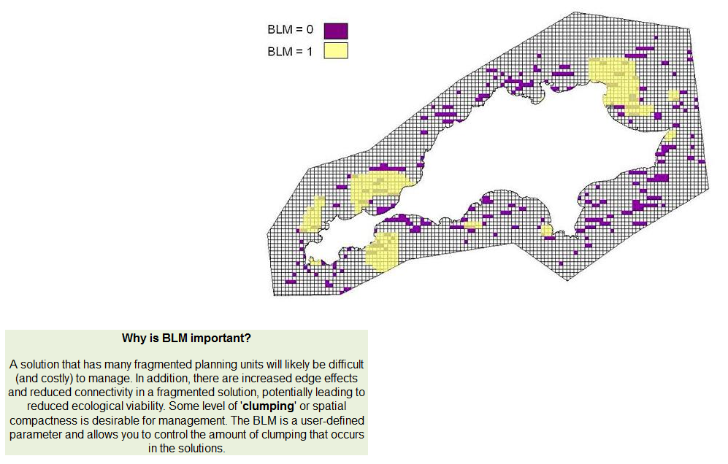
Importance of boundary length
Reserve designs with many fragmented planning units may be difficult to manage.
Edge effects & reduced connectivity may leas to reduced ecological vaiabiltiy.

Slide 19
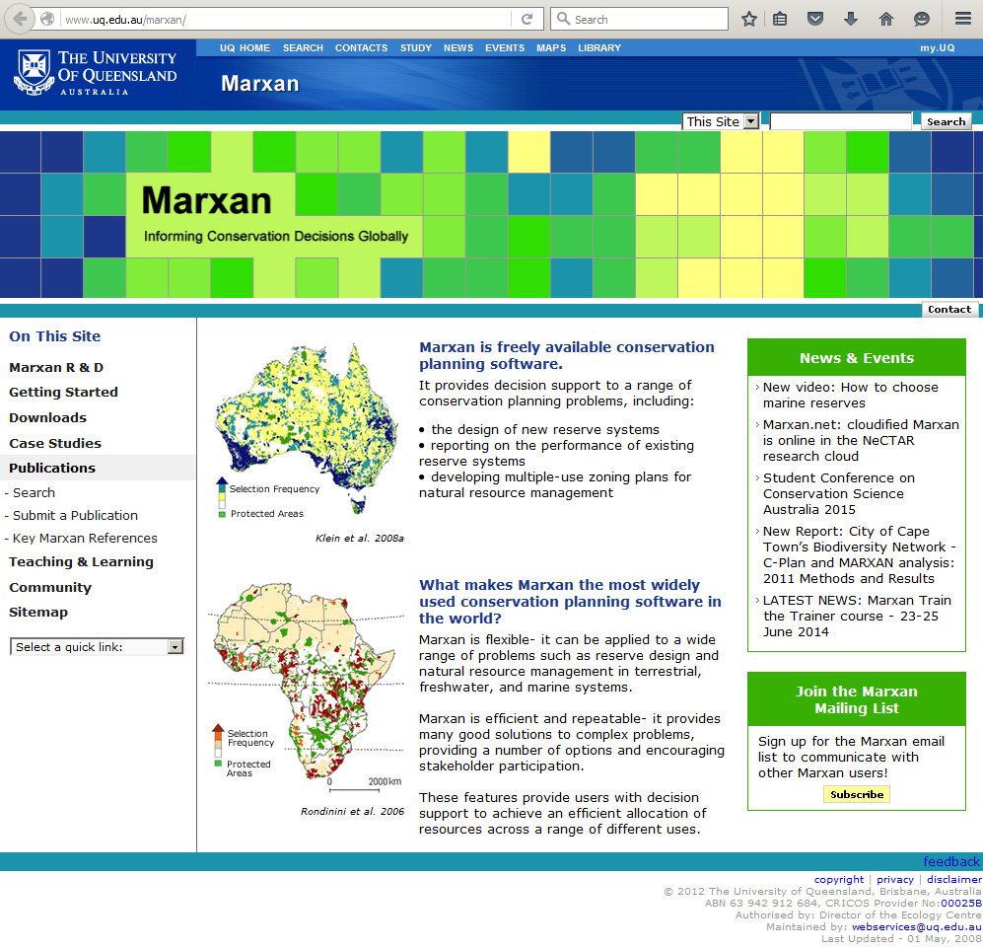
Marxan (http://www.uq.edu.au/marxan/)
Addresses core Systematic Conservation Planning principles.
Identifies multiple good solutions, even to very large problems.
Systematic, repeatable and transparent area selection.
Easy to use.
FREE

Slide 20
How Marxan works
For a given reserve design, Marxan calculates:
Score = Cost + Boundary Length + Penalty for unmet targets
Marxan takes information on:
Planning unit status (in/out of reserve)
Costs of planning unit site selection.
Ecosystem features associated with each planning unit.
Feature Targets (linked to management objective)
Costs of connectivity among planning units (spatial relationships for boundary calculations)

Slide 21
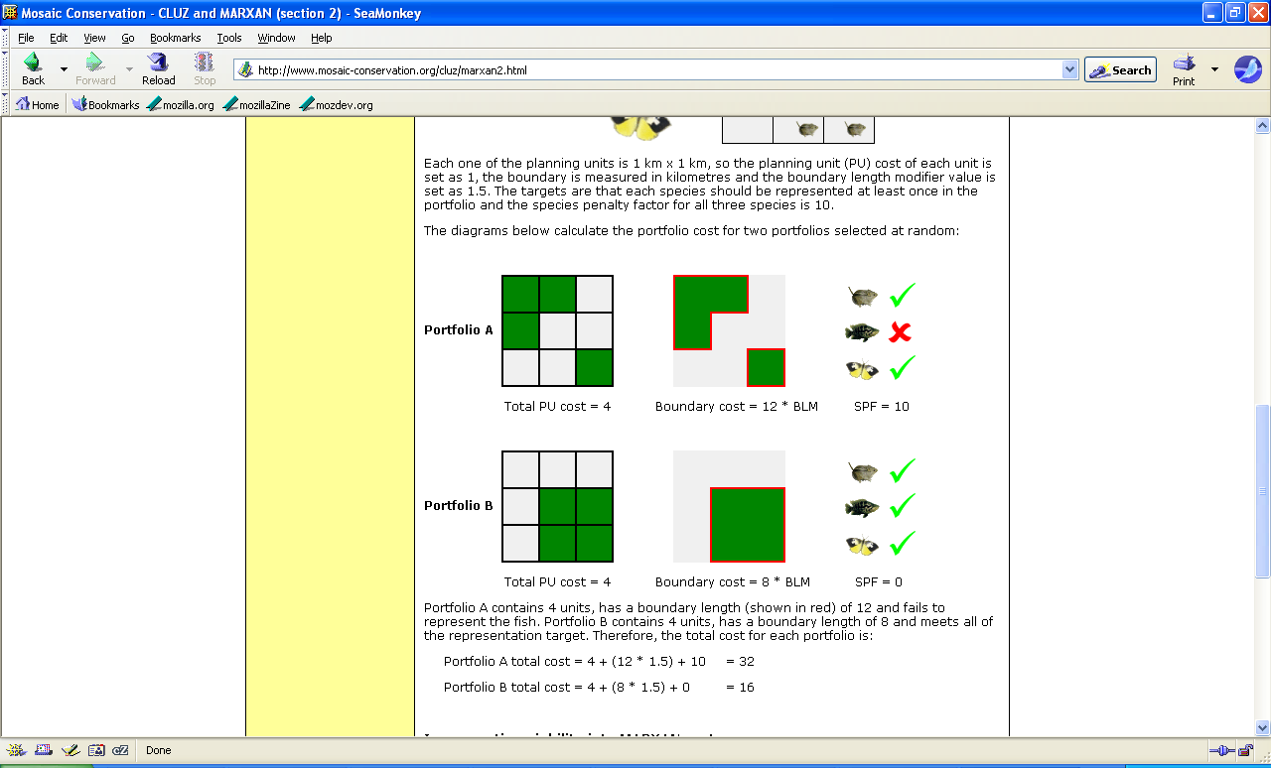
26
12
Source: Bob Smith (DICE)

Slide 22
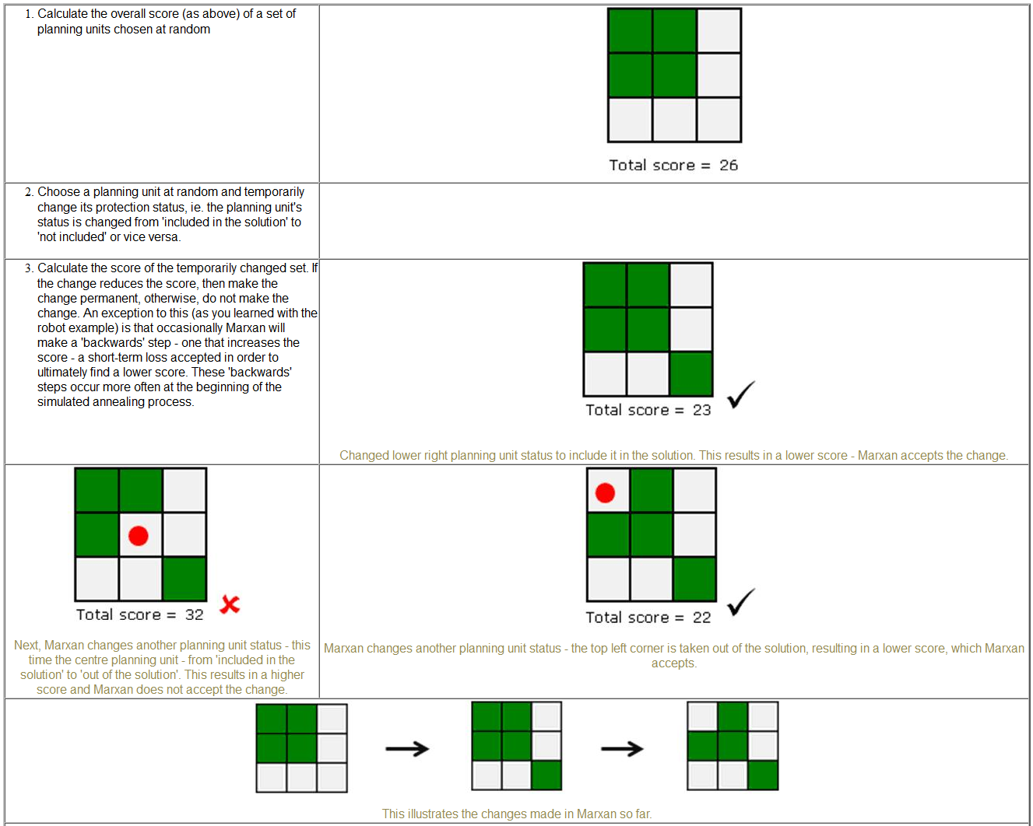
Marxan algorithm employs simulated annealing

Slide 23
Selection frequency
Simulated annealing is a stochastic process and also dependent on initial conditions.
Does not necessarily find the minimum.
Solution: Run many times to obtain multiple solutions, compare solutions to see how they differ in terms of meeting targets, cost, etc.
We can use selection frequency to identify those areas most important to solutions.
number of times a particular unit was included in a solution.
These areas may be considered as having high irreplaceability and therefore receive high priority.

Slide 24
Species penalty factor
Marxan calculates whether the target for each conservation feature is met
includes a cost for any target that has not been met (as specified by the species penalty factor).
These penalty factors can be generic or feature-specific.
If all targets are not being met, increasing these penalties makes it more likely that all targets will be met.

Slide 25
Using Marxan

Slide 26
Input files
Planning Unit File
Conservation feature file
Planning Unit vs Conservation Feature File
Boundary Length file
Input Parameter file

Slide 27
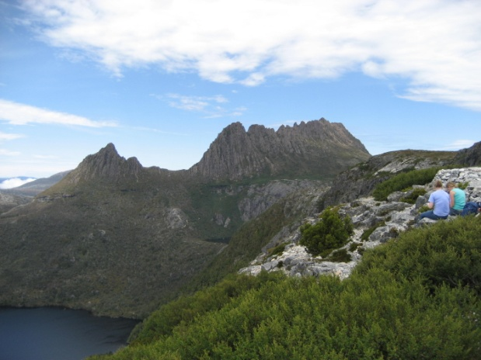
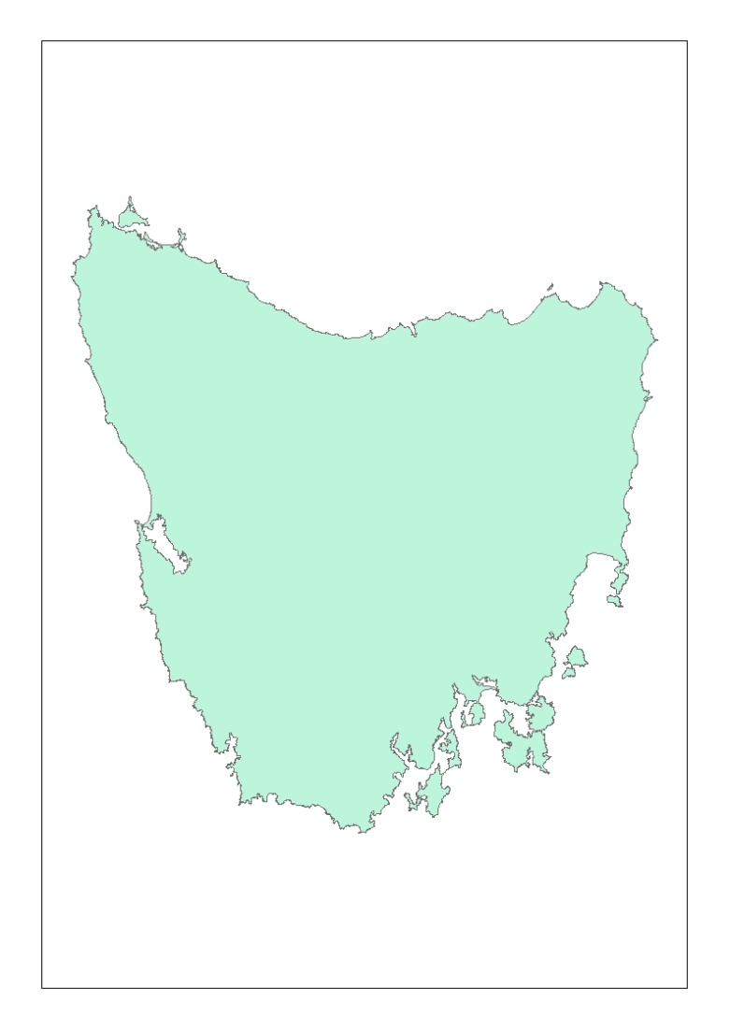

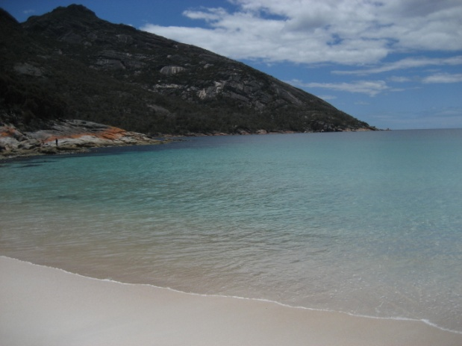

Planning Region
Tasmania

Slide 28
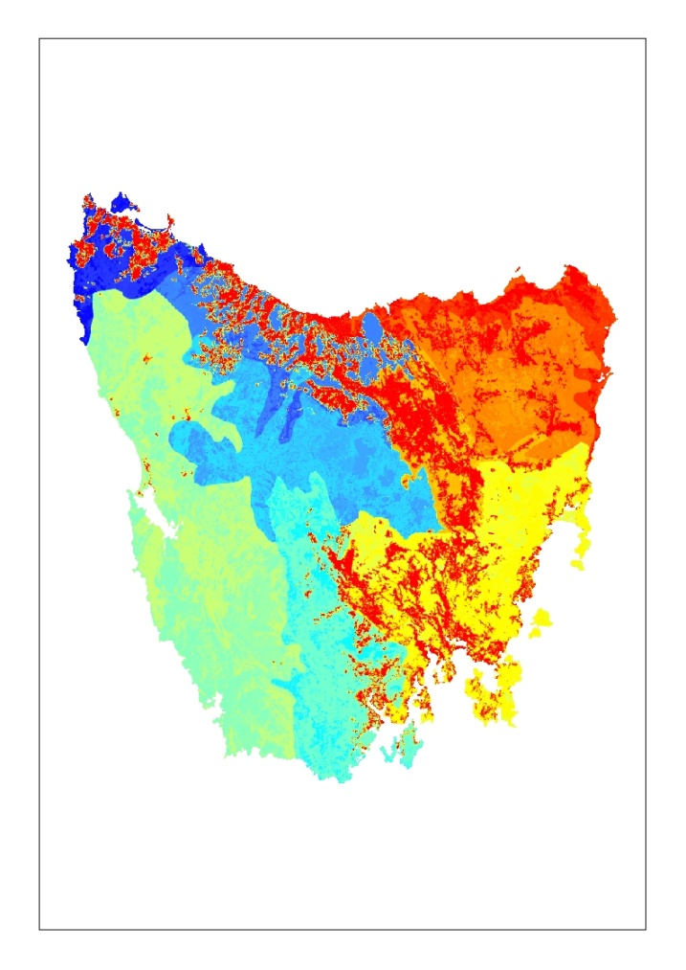
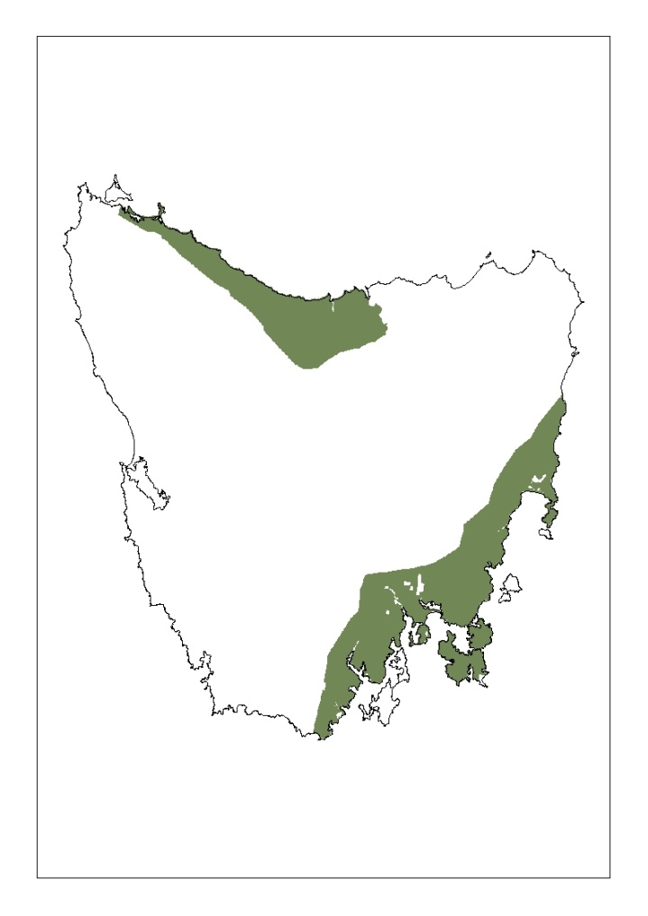
Gather conservation feature data
Vegetation types
Distribution data for a bird

Slide 29
Key data requirements
Planning units
Cost of each planning unit
Conservation features
Amount of each feature in each planning unit
Boundaries between planning units

Slide 30
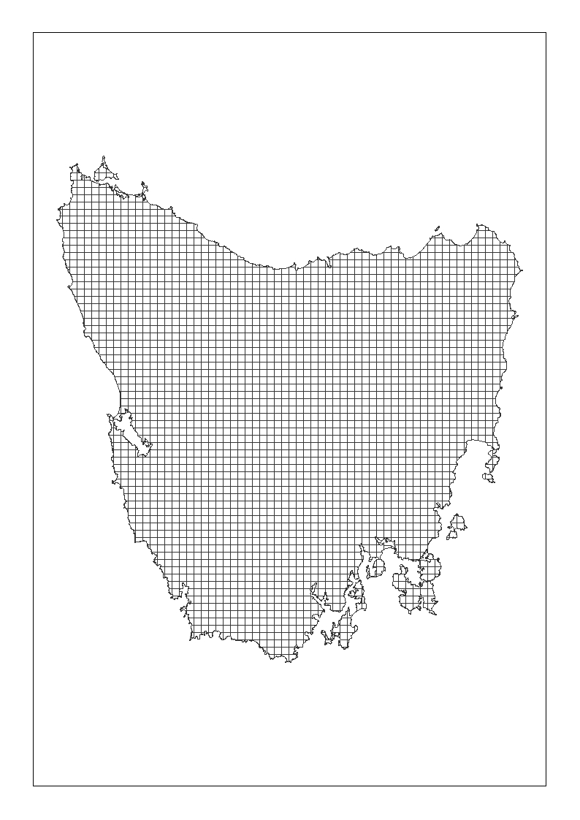
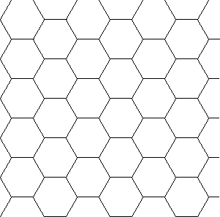
Planning units
Different types/ sizes
Hexagons
Environmental units

Slide 31
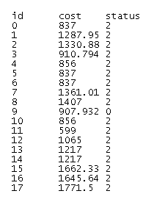
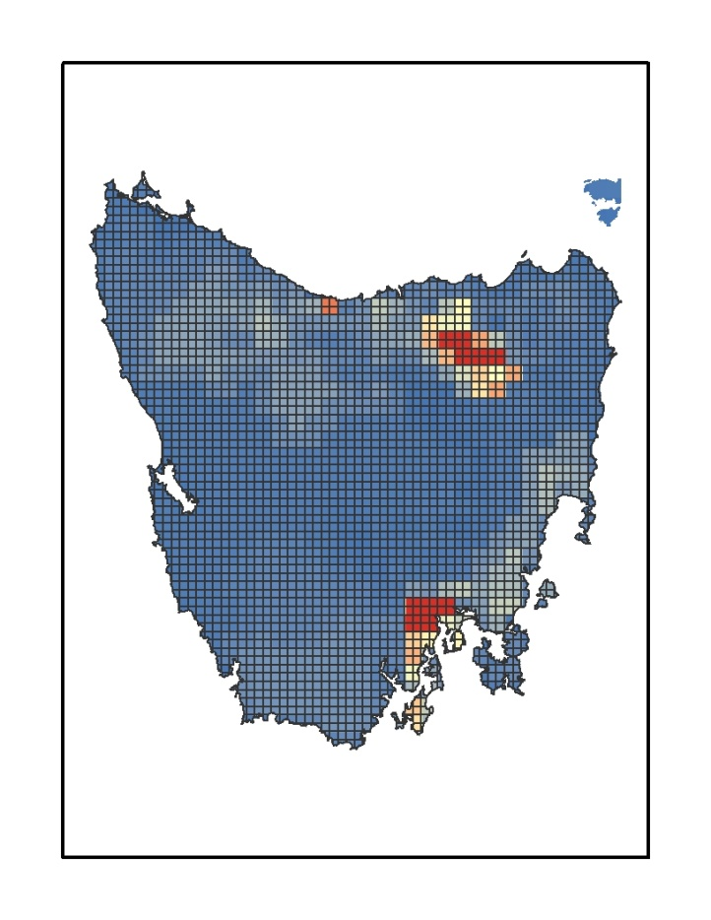
Pu.dat
id=Planning units
cost=How much each planning
unit “costs”

Slide 32
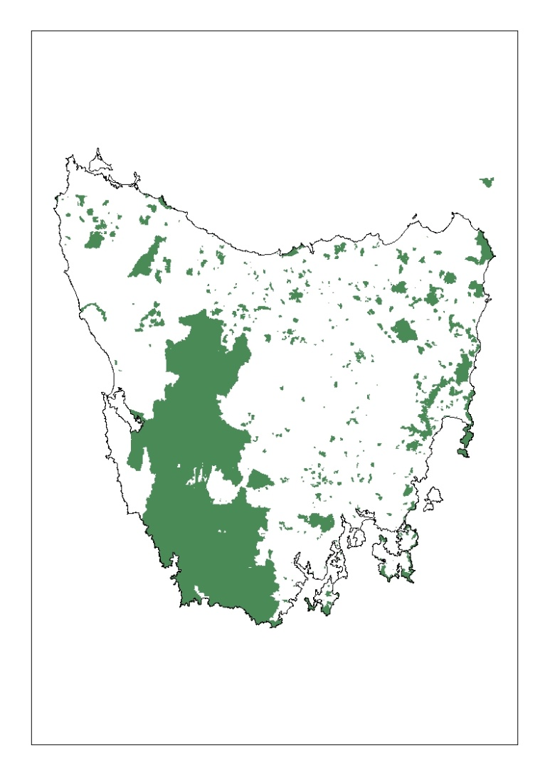
Pu.dat
status
Lock in (2): Are there areas
that are already protected?
Lock out (3): Are there areas
that can’t be included?
Current reserve areas in Tasmania

Slide 33
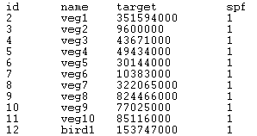
Spec.dat
A list of all your conservation features (id), the targets you have set for them (target), and a penalty factor (spf)

Slide 34
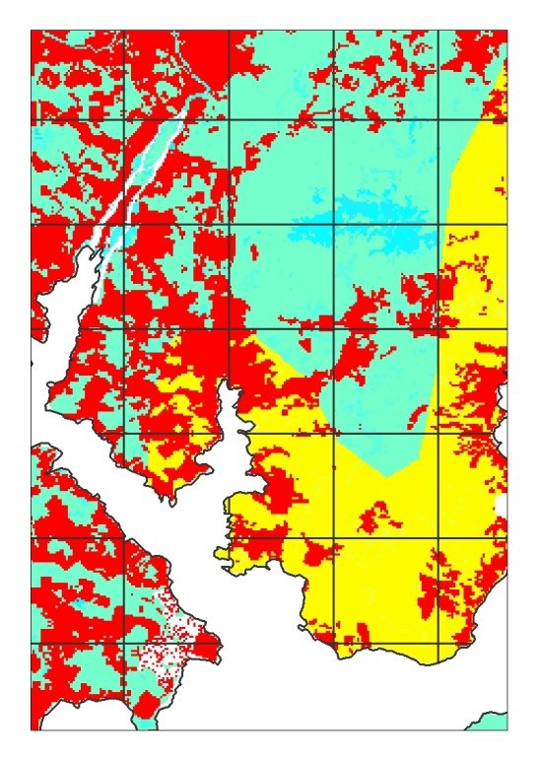
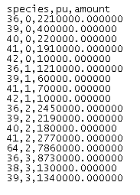
Puvsp.dat
Combines your conservation
feature data with your planning
units (how much of each feature is
in each planning unit?)

Slide 35
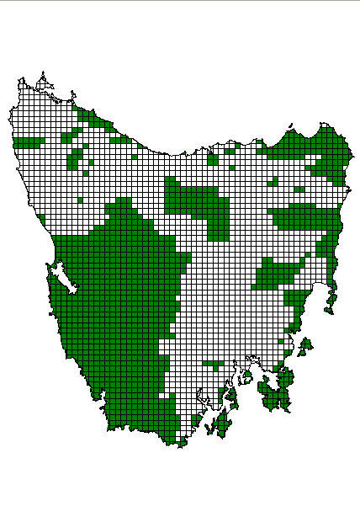
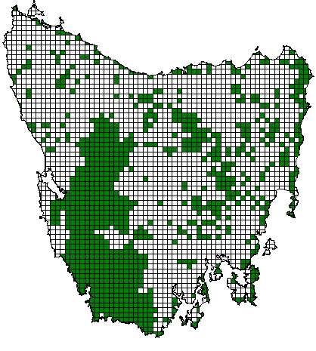
Bound.dat
Marxan can find clumped solutions
But it needs information about the boundaries between the planning units to do this.

Slide 36
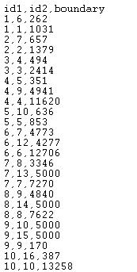
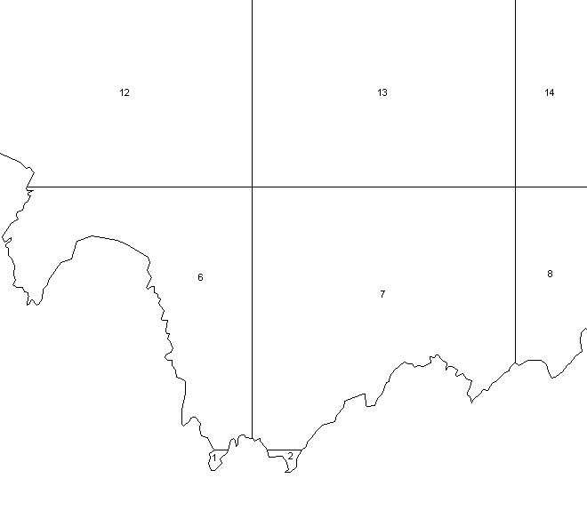
Bound.dat

Slide 37
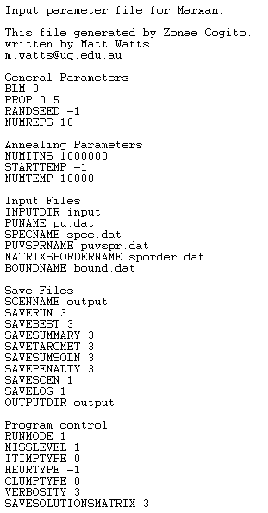
Input.dat
Instructions for Marxan
Where to find the input files
Set some parameters
(BLM, number of solutions)
Where to put the output files

Slide 38
Parameter Setting
Some you will need to set:
Runs (restarts of the program)
Iterations (number of times Marxan tries to find a good solution)
BLM (how much clumping)
Some are standard and are not typically changed:
Temperature settings
Annealing parameters
Program controls

Slide 39
Tradeoffs – Area/Cost vs. Boundary

Slide 40
Output Files
Best Solution (shows which planning units were selected in the solution with the lowest objective function score)
Summed Solution (shows the selection frequency of each planning unit)
Summary (for each run: score, cost, boundary length, etc.)
Missing Value (amount of each feature in a solution, target met, etc.)
Log (what you see on the screen when Marxan is running)
More…

Slide 41
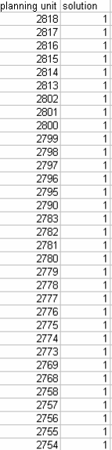
Individual Solutions
Use: Every solution has a file that can be displayed as a map.
The planning units chosen in individual solutions are complementary
“Best” Solution (shows planning units selected in the solution with the lowest objective function score)

Slide 42
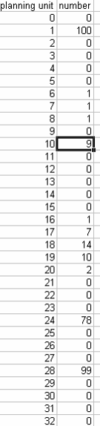
Selection Frequency
Ssoln (Summed Solution) files show the selection frequency of each planning unit
Selection frequency is not a solution and is not complementary
Use: A map of this file can help identify areas that are always, often, rarely, or never included across all of the Marxan runs in a scenario.
Selection Frequency

Slide 43
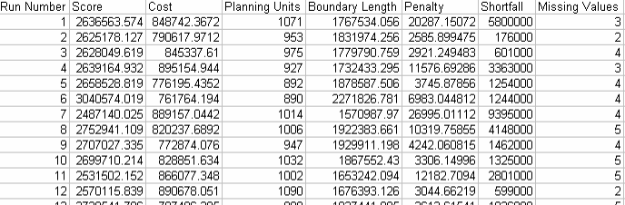
Summary
Use:
compare runs
check for missing values and shortfall(calibrate spf)

Slide 44
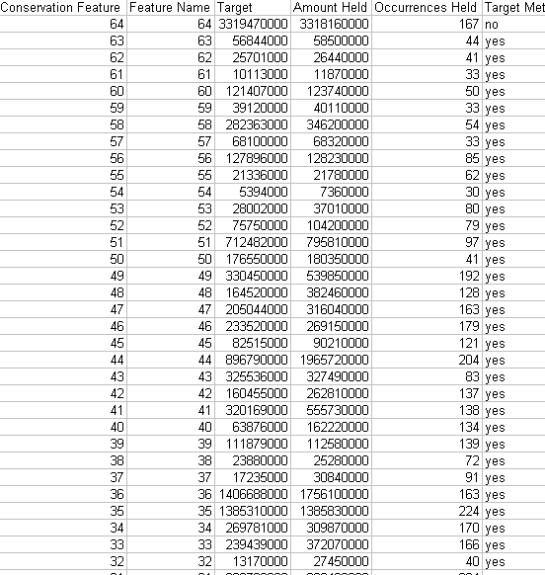
Missing Value
Use: For a particular solution, you can examine conservation feature target achievement

Slide 45
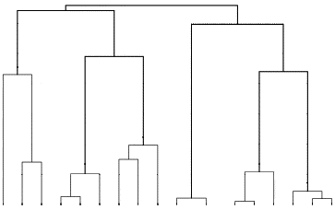
Cluster analysis of Marxan solutions
Dendogram with 17 solutions

Slide 46
Why use a decision support tool?
There are many different MPA configuration possibilities – hard to find by hand.
Tools find many possible solutions, quicker.
Help consider multiple factors (costs, biodiversity, spatial constraints).
Systematic, repeatable, transparent.

Slide 47
Many decision support tools out there…
C-Plan (Bob Pressey and Matt Watts)
http://www.uq.edu.au/~uqmwatts/cplan.html
Zonation (Atte Moilanen)
http://www.helsinki.fi/bioscience/consplan/index.html
ResNet (Sahotra Sarkar)
http://uts.cc.utexas.edu/~consbio/Cons/Labframeset.html
More...Ecosystem Based Management Tools Network
www.ebmtools.org/

Slide 48
Key Messages
Computational capacity or algorithms rarely limit conservation planning – lack of clear objectives do.
Most issues arise because of communication challenges.
Many complexities can be added
More complex spatial rules
Zoning
Uncertainty
Dynamics

Slide 49
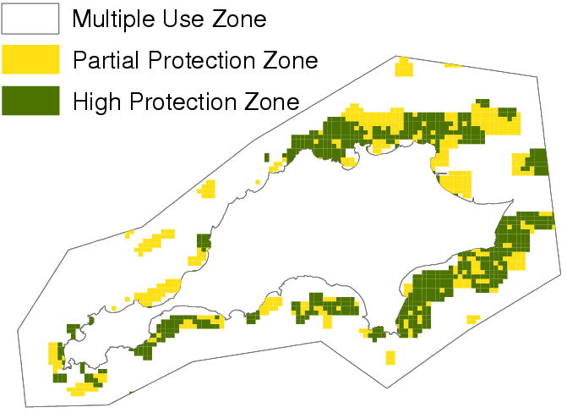
Marxan with Zones
Zones conservation areas with different levels of protection
Zone for multiple uses in the land and sea
Fishing Zones!
Klein et al. 2009. Frontiers in Ecology and the Environment
Wilson et al. 2009. Ecological Applications
Watts et al. 2009. Environmental Modelling and Software

Slide 50
Key Messages
Computational capacity or algorithms rarely limit conservation planning – lack of clear objectives do.
Most issues arise because of communication challenges.
Many complexities can be added
More complex spatial rules
Zoning
Uncertainty
Dynamics

Slide 51
Next time on Models for Marine EBM….
(April 1)
Valuation of Ecosystem Services
INVEST

Slide 52
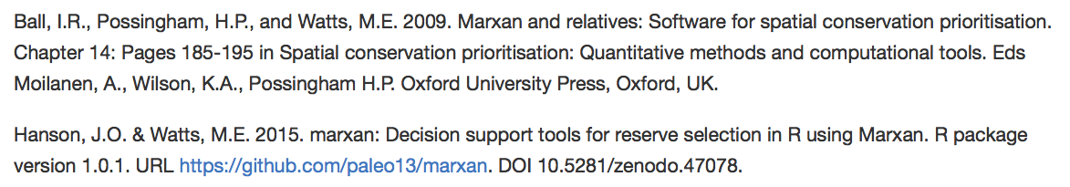
Lab exercise - MaRxan tutorial
library(marxan)
vignette('tutorial', package='marxan')
All Marxan workflow integrated into R.
Info for data files contained within R objects

Slide 53
Assignment
Rottnest island

